Slide 1
Recommending a South Indian Restaurant in Leeds
Coursera capstone project for ibm data science
Omar Imran – July 20

Slide 2
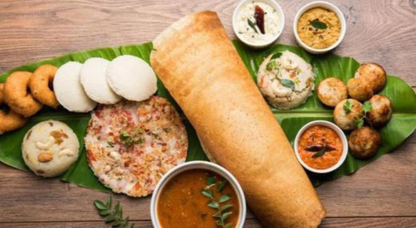

Intro
A relative wants to open a South Indian restaurant in Leeds, England.
Leeds is a diverse city with restaurants of many cuisines, but perhaps a gap in the market for South Indian?

Slide 3
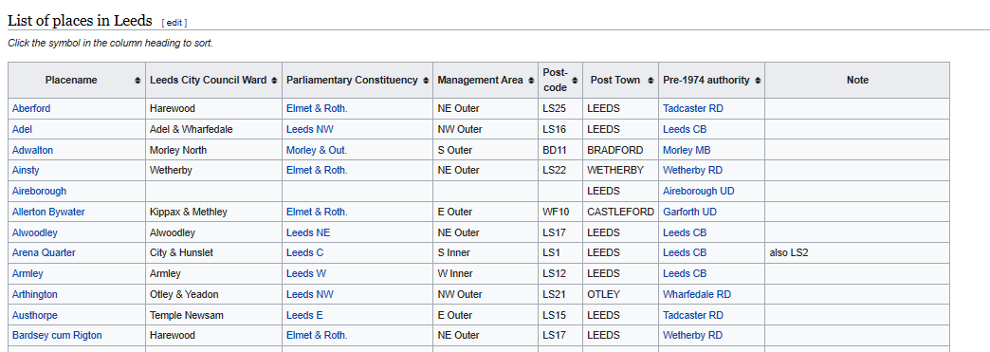

Data
There is an existing online wikipedia article which lists different places in Leeds as well as their postcode (https://en.wikipedia.org/wiki/List_of_places_in_Leeds).
Foursquare API will be used to get the data of the venues at each of these places. Notable venue types of interest will be the different types of restaurants, particularly (South) Indian restaurants.

Slide 4
Methodology
Importing libraries
Scraping Leeds neighbourhoods from Wikipedia Geocoding the places in Leeds – the places are geocoded one by one and corresponding latitude and longitude are stored in the dataframe. This dataframe is saved for reference.
Superimpose places on map
Explore venues with Foursquare
Clustering analysis
Clustering analysis repeated for custom created feature
Clustering analysis repeated by normalising all features

Slide 5
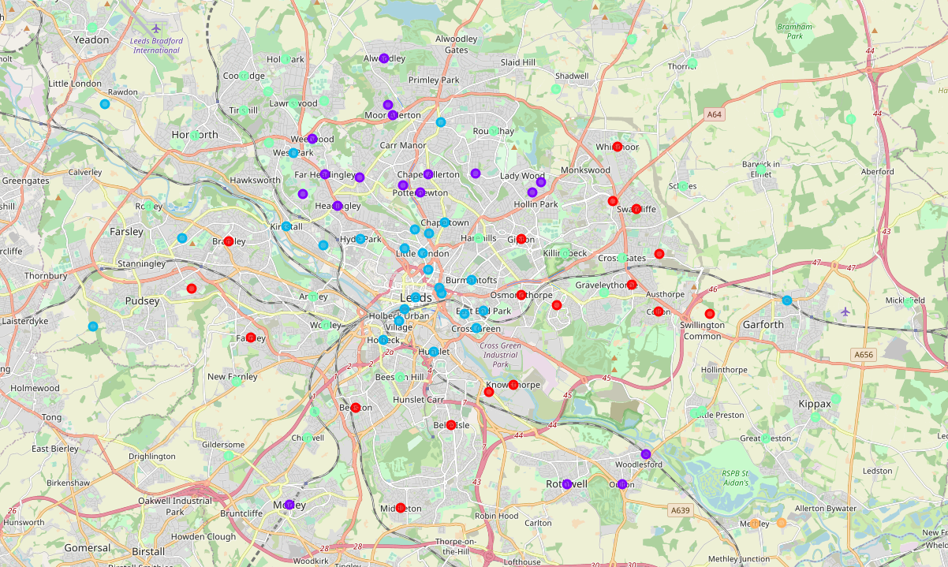
Clustering analysis #1
Cluster 0 seems fast food dominant, Cluster 1 seems Italian restaurant dominant, Cluster 2 seems Thai/Indian dominant, Cluster 3 seems to be Vietnamese dominant which in this case due to ordering convention means there is a lack of restaurants in this area, Cluster 4 have only one unspecified cuisine restaurant.

Slide 6
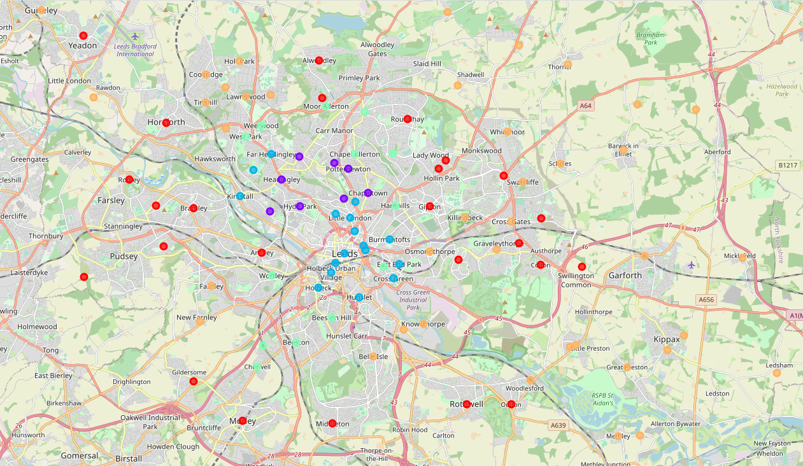
Clustering analysis #2
Cluster 0 has 3-7 total restaurants in each place of varying cuisine, cluster 1 has 18-21 restaurants in each place of mainly Thai/Italian cuisine, cluster 2 has 12-18 restaurants in each place of Thai/Indian cuisine, cluster 3 has 8-13 restaurants of varying cuisine and cluster 4 has mainly Jewish restaurants which by the numbering convention actually means it has 0-1 total restaurants per place.

Slide 7
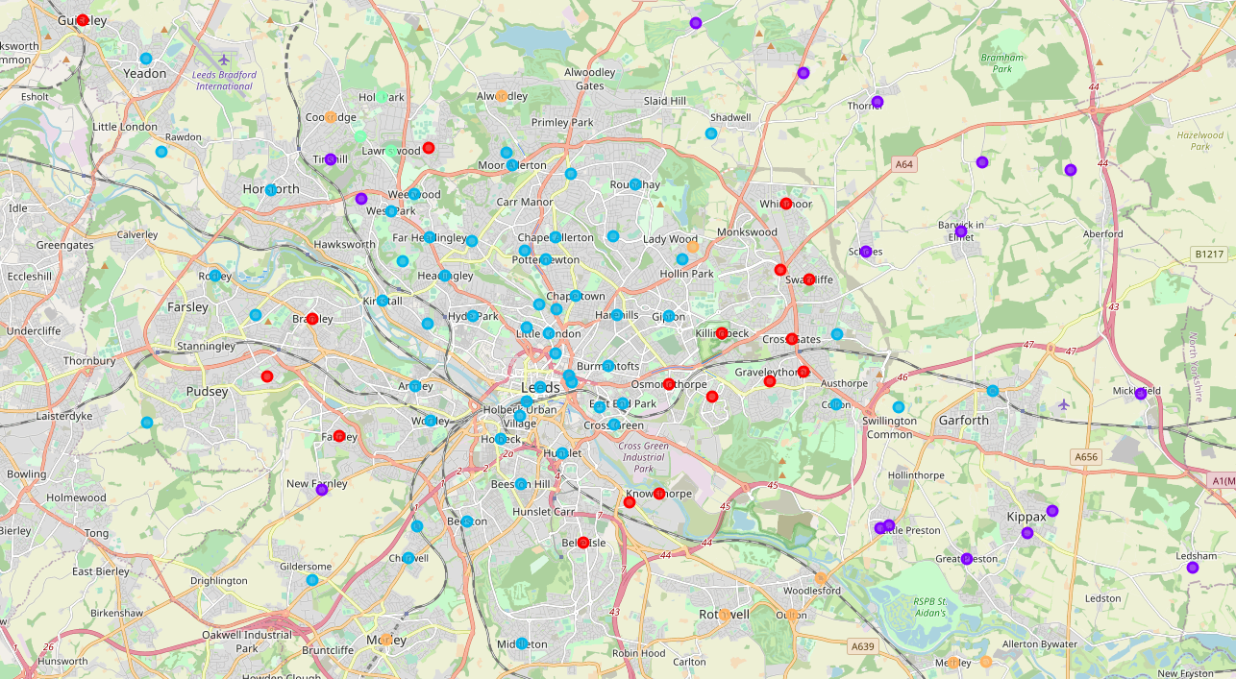
Clustering analysis #3
Cluster 0 has 1-3 restaurants per place, primarily fast food. Cluster 1 has 0 restaurants per place. Cluster 2 has variety of types of cuisines and is hard to define as a cluster. Cluster 3 has only one Italian restaurant per place. Cluster 4 is dominated by unspecified 'restaurant' type.

Slide 8
Discussion
Firstly, there is not enough data on restaurants. Even when increasing the venue reach to 2km (quite a large allowance for a town centre)
From the first analysis - Cluster 2 seems of most interest for an Indian restaurant owner, and cluster 2 is based centrally on the map. Thus, there may be a lot of competition in central Leeds for an Indian restaurant and perhaps more of a market niche in other areas (particularly cluster 3 as there are no restaurants here. On the other hand, this could mean that there is only a taste for Indian food in central Leeds.
The further 2 analyses did not deliver any surprising insights. Thus, the new feature didn’t seem to contribute much to useful analysis. It was rather expected that there would be more restaurant in the centre of Leeds. The new feature didn’t seem to highlight how Indian restaurants varied in high population areas, which was the initial aim.

Slide 9
Conclusion
If more restaurants existed within a 2km radius of the centres of the different neighbourhoods in Leeds, then clustering could be more insightful. What is clear is that there is a lack of restaurants in many areas in outer Leeds or perhaps just a low number of restaurants registering their location close to the town centre.
So, there is indeed a market gap in outer-Leeds town centres. Also, the dominant restaurant cuisine in central Leeds seems to be Thai food, followed by Indian. Thus, there is a taste for India in central Leeds which could be profited upon.
In summary, I would advise to open a restaurant just outside the centre of Leeds, to capture the Leeds market interest in Indian food, but to stay further away from dense market competition.

